Slide 1

ADM Blockchain COE
May 2017

Slide 2
Blockchain Focus
ADM offers a unique setting for POC elaboration (Loyalty Point, KYC, Trade Finance)
Capgemini collaborates with the leading Blockchain startups (Symbiont, BigChainDB, Eris, etc…)
Capgemini released “Evaluation Framework” (2015) and a Viewpoint on “Smart Contracts” (2016)
Partner with leading Blockchain
Start-ups
Team of Blockchain
Experts accelerates BC Development
POC Building
(6 Concepts)
Blockchain
Research and
Analysis
Participate in leading Open Source initiatives
Capgemini participates in leading open source development for Blockchain (Hyperledger, Corda)
Capgemini is expanding its team of Blockchain experts to 50 people by Q2 2017

Slide 3
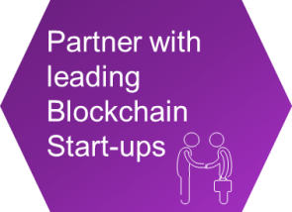








Capgemini alliances with leading Blockchain Start-ups
Our Partnership Agreements
Our Connection with Startups

Slide 4
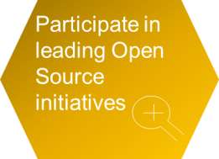



Active engagement with Open Source community
Community :
40+ Corporations
Capgemini has joined as an Individual membership
Capgemini is a contributor to Use Cases WG
We are an active participant on Slack
Future Opportunities :
Hyperledger has the potential to provide a common infrastructure layer for Blockchain based on which open platforms and Dapps can be developed
Still in early stage of development
Community :
80 of the world's leading financial institutions
Capgemini was part of Corda Early Access Programme
We are an active participant on Slack
Future Opportunities :
Corda has the potential to record, manage and synchronise financial agreements between regulated financial institutions
Still in early stage of development

Slide 5
Blockchain Hackathon Journey and Outcomes
3000 Hours of Training and Hands-on lab sessions delivered on niche emerging skills
Training Workshops
5-Days comprehensive hands-on training on Hyperledger provided by ADM Training and IBM team to all participants
1200 Participants across ADM and other practices up-skilled during Hackathon week
100 Finalists across 20 teams selected for Hackathon Finale through Technical Assessments
Level 1 – Technical Assessment
Technical competency assessment of all participants. Successful participants qualify for Hackathon Finale
4 solutions - Blockchain published
Level 2 – Hackathon Code Challenge
Code challenges with 3 business scenarios in to solve in 1.5 Days
7+ proposals

Slide 6

Portfolio of Proof of Concepts
Digital Loyalty Tokens Platform that enables multi-tenant, cross-platform collaboration and a de-centralized exchange for easy and quick conversion of Loyalty tokens
Loyalty
Using blockchain the customers KYC details will be shared across all banks / intra-bank departments and every banks / intra-bank department will have same master copy of KYC data as others. This solution is developed in both Hyperledger Fabric and R3 Corda
Know Your Customer
(KYC)
This solution enables insurance policies to be shared across different regions and provides the customer to have a single program/policy to insure their assets in different geographical region
International Insurance Policy
This solution automates the still manual trade finance process by transforming letters of credit to smart contracts with automated payments, digitizing printed documents such as bills of landing and storing them
as metadata, and creating a record of ownership in each step
Trade Finance
Blockchain solution for Payment Service Directory 2 (PSD2) targets to create a common framework and standard for Third Parties and Financial Institutions to authorize transactions between 2 parties
PSD2 Compliance
Fiat-Relay is an open source initiative by Capgemini and a partner bank to connect Smart Contracts to Traditional Payment Services
Fiat - Relay
Notes:
Key Talking points:
We have developed a set of POCs (to broaden our business and technical experience)
We picked some areas with most specific opportunities that resonate well with our customer base

Slide 7
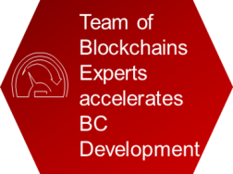
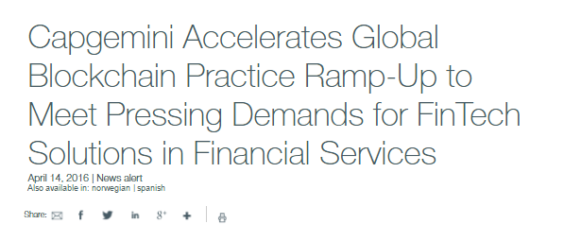

Our Team of Blockchain Experts
Business and Technical Skills
Python, Golang and Java
Ethereum / Solidity Smart Contract; Chaincode
BigChainDB Platform
Expanding to Hyperledger / Corda, etc based on client Needs
Development Teams in US, Europe and India
Ability to leverage our off-shore development and training center
Ability to locate tech resources within client teams

Slide 8
KYC PoC

Slide 9
KYC Usecase Overview
Requirement:
Simplify the KYC process to implement single KYC for one and the same inter-bank / intra-bank customers
Problem Statement:
KYC and AML frameworks require banks to verify client identities. This process has various manual steps, involves many different institutions and is often duplicated among departments and other banks for one and the same customers
Solution:
Using blockchain the customers KYC details will be shared across all banks / intra-bank departments and every banks / intra-bank department will have same master copy of KYC data as others
This would potentially reduce the need for KYC and AML vetting and associated compliance costs every time a customer engages in a new product with another bank department or joins a new bank, while the cryptography can ensure data security.

Slide 10

KYC: Current State Architecture without Blockchain
KYC Enrollment
1. Bank1 /
Bank1 Dept 1
2. Bank2 /
Bank1 Dept 2
3. Bank3 /
Bank1 Dept 3
4. Bank4 /
Bank1 Dept 4
“In house” (ledger)
“In house” (ledger)
“In house” (ledger)
“In house” (ledger)
Regulator/User
Regulator/User
Regulator/User
Regulator/User

Slide 11
KYC: End State Architecture with Blockchain
KYC Enrollment
node
node
1. Bank1 /
Bank1 Dept 1
Shared Ledger
Smart Contracts
2. Bank2 /
Bank1 Dept 2
5. Regulator
node
node
Records of KYC registration
Conditions for KYC registration
node
node
4. Bank4 /
Bank1 Dept 4
3. Bank3 /
Bank1 Dept 3

Slide 12
Appendix

Slide 13
What Is Blockchain Technology?
What is Blockchain?
What are Distributed ledgers?

Slide 14

Blockchain example
Current world scenario: Transaction within same bank:
Barclays Bank
5
Alice
Bob
Barclays Ledger before transaction :
Barclays Ledger after transaction :
Id | Holder | Currency | Amount
1 | Alice | USD | 10
2 | Bob | USD | 5
Id | Holder | Currency | Amount
1 | Alice | USD | 5
2 | Bob | USD | 10

Slide 15
Blockchain example (contd..)
Current World Scenario: Transaction between different banks:
Barclays Bank
Interface
HSBC Bank
5
Alice
Correspondent Banking Arrangement
Charlie
Barclays Ledger before transaction :
HSBC Ledger before transaction :
Id | Holder | Currency | Amount
1 | Alice | USD | 10
2 | HSBC | USD | 1000
Id | Holder | Currency | Amount
1 | Charlie | USD | 5
2 | Barclays | USD | -1000
Barclays Ledger after transaction :
HSBC Ledger after transaction :
Id | Holder | Currency | Amount
1 | Alice | USD | 5
2 | HSBC | USD | 995
Id | Holder | Currency | Amount
1 | Charlie | USD | 10
2 | Barclays | USD | -995
Notes:
Correspondent Banking arrangement: The correspondent banking arrangement allows banks to facilitate payments between their respective customers, by creating Bank accounts as you can see on the screen. Barclays owe HSBC 1000$ and it is depicted in the ledgers of both Barclays and HSBC. It only works if the two banks have a direct relationship with each other. If they don’t, you either can’t make the payment or need to route it through a third (or fourth!) bank until you can complete a path between the two banks
SWIFT messaging: The SWIFT network exists to allow banks securely to exchange electronic messages with each other
RTGS (Real Time Gross Settlement): If the major banks in a country all hold accounts with the central bank (RBI) then they can move money between themselves simply by instructing the central bank to debit one account and credit the other

Slide 16
What are the issues with Current World Systems?
Key Issues with existing systems – 
Need for an interface between the banks
Need to maintain correspondent banking arrangement
Reconciliation of data
Duplication of data
Different systems for Auditors
Duplication of logic for processing the transactions
Huge cost

Slide 17
Blockchain example (contd..)
Blockchain World Scenario: Transaction between different banks:
Barclays Bank
HSBC Bank
5
Alice
Charlie
Distributed Ledger before transaction :
Id | Issuer | Holder | Currency | Amount
1 | Barclays | Alice | USD | 10
2 | HSBC | Charlie | USD | 5
Distributed Ledger after transaction :
Id | Issuer | Holder | Currency | Amount
1 | Barclays | Alice | USD | 5
2 | HSBC | Charlie | USD | 10

Slide 18
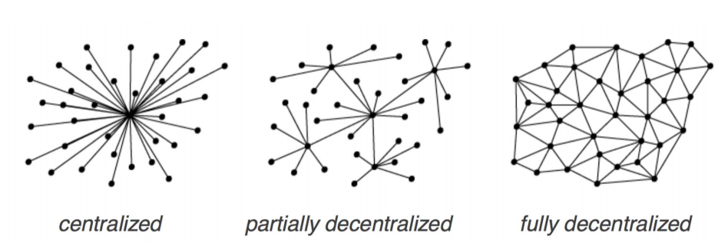
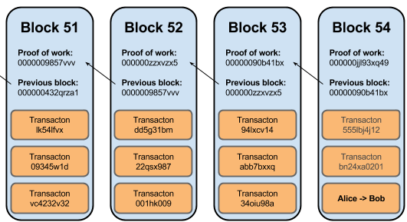
What Is Blockchain Technology? Lets revisit again…
Distributed ledgers are systems that enabled parties
who dont fully trust each other
to form and maintain consensus
about the existence, status and evolution of a set of shared facts
spread across multiple sites/countries/institutions (nodes)
A Blockchain is
a type of distributed ledger
comprised of unchangeable, digitally recorded data(transactions)
bundled in packages called blocks
these blocks are linked to each other to form a chain
Notes:
DL Transfer value at-a-distance with no trusted third party. There is no central system. The value is transferred using smart contract
To give an example, Ethereum, Hyperledger are Blockchains and R3 Corda is a distributed ledger

